Slide 1

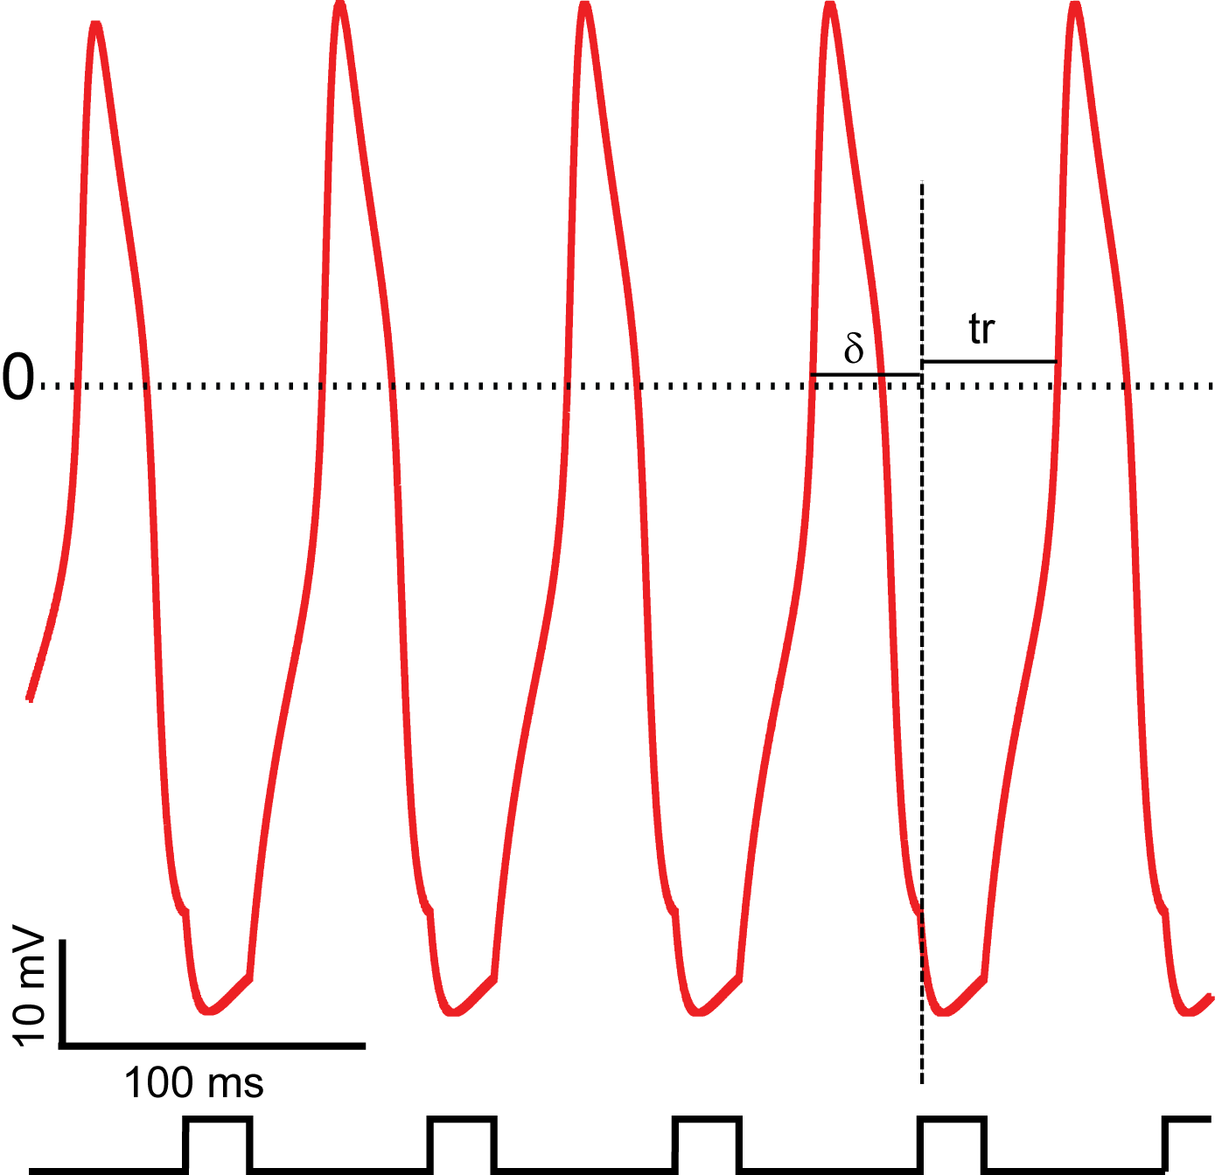
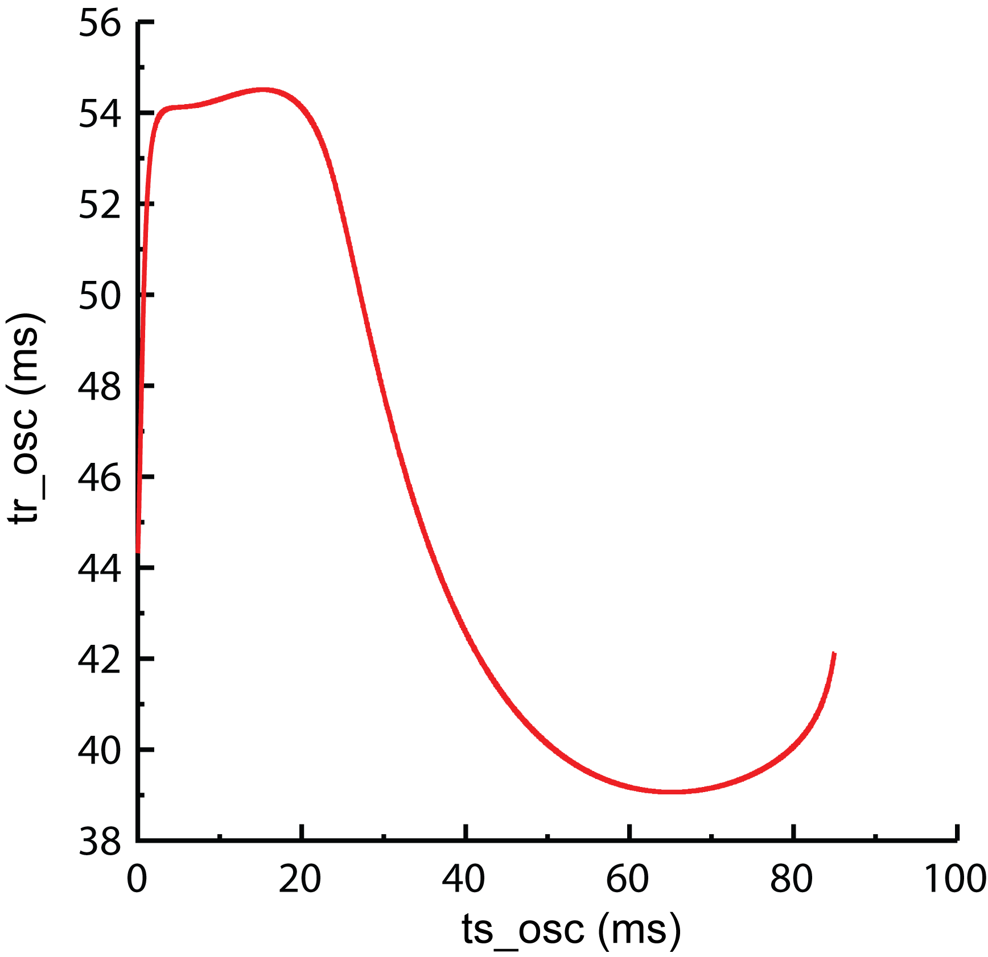
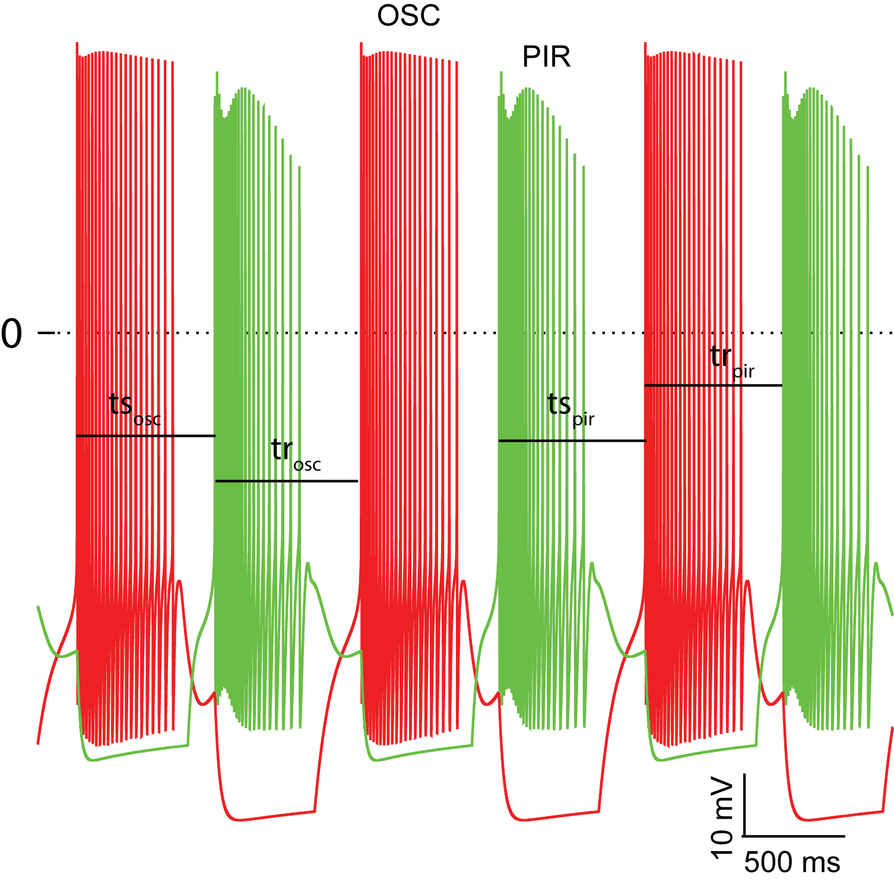
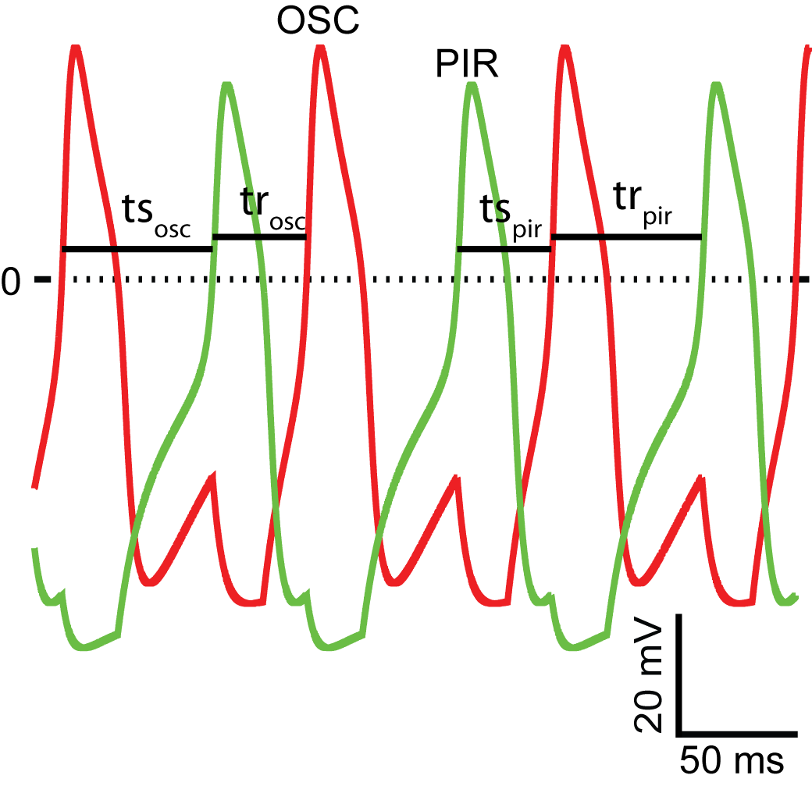
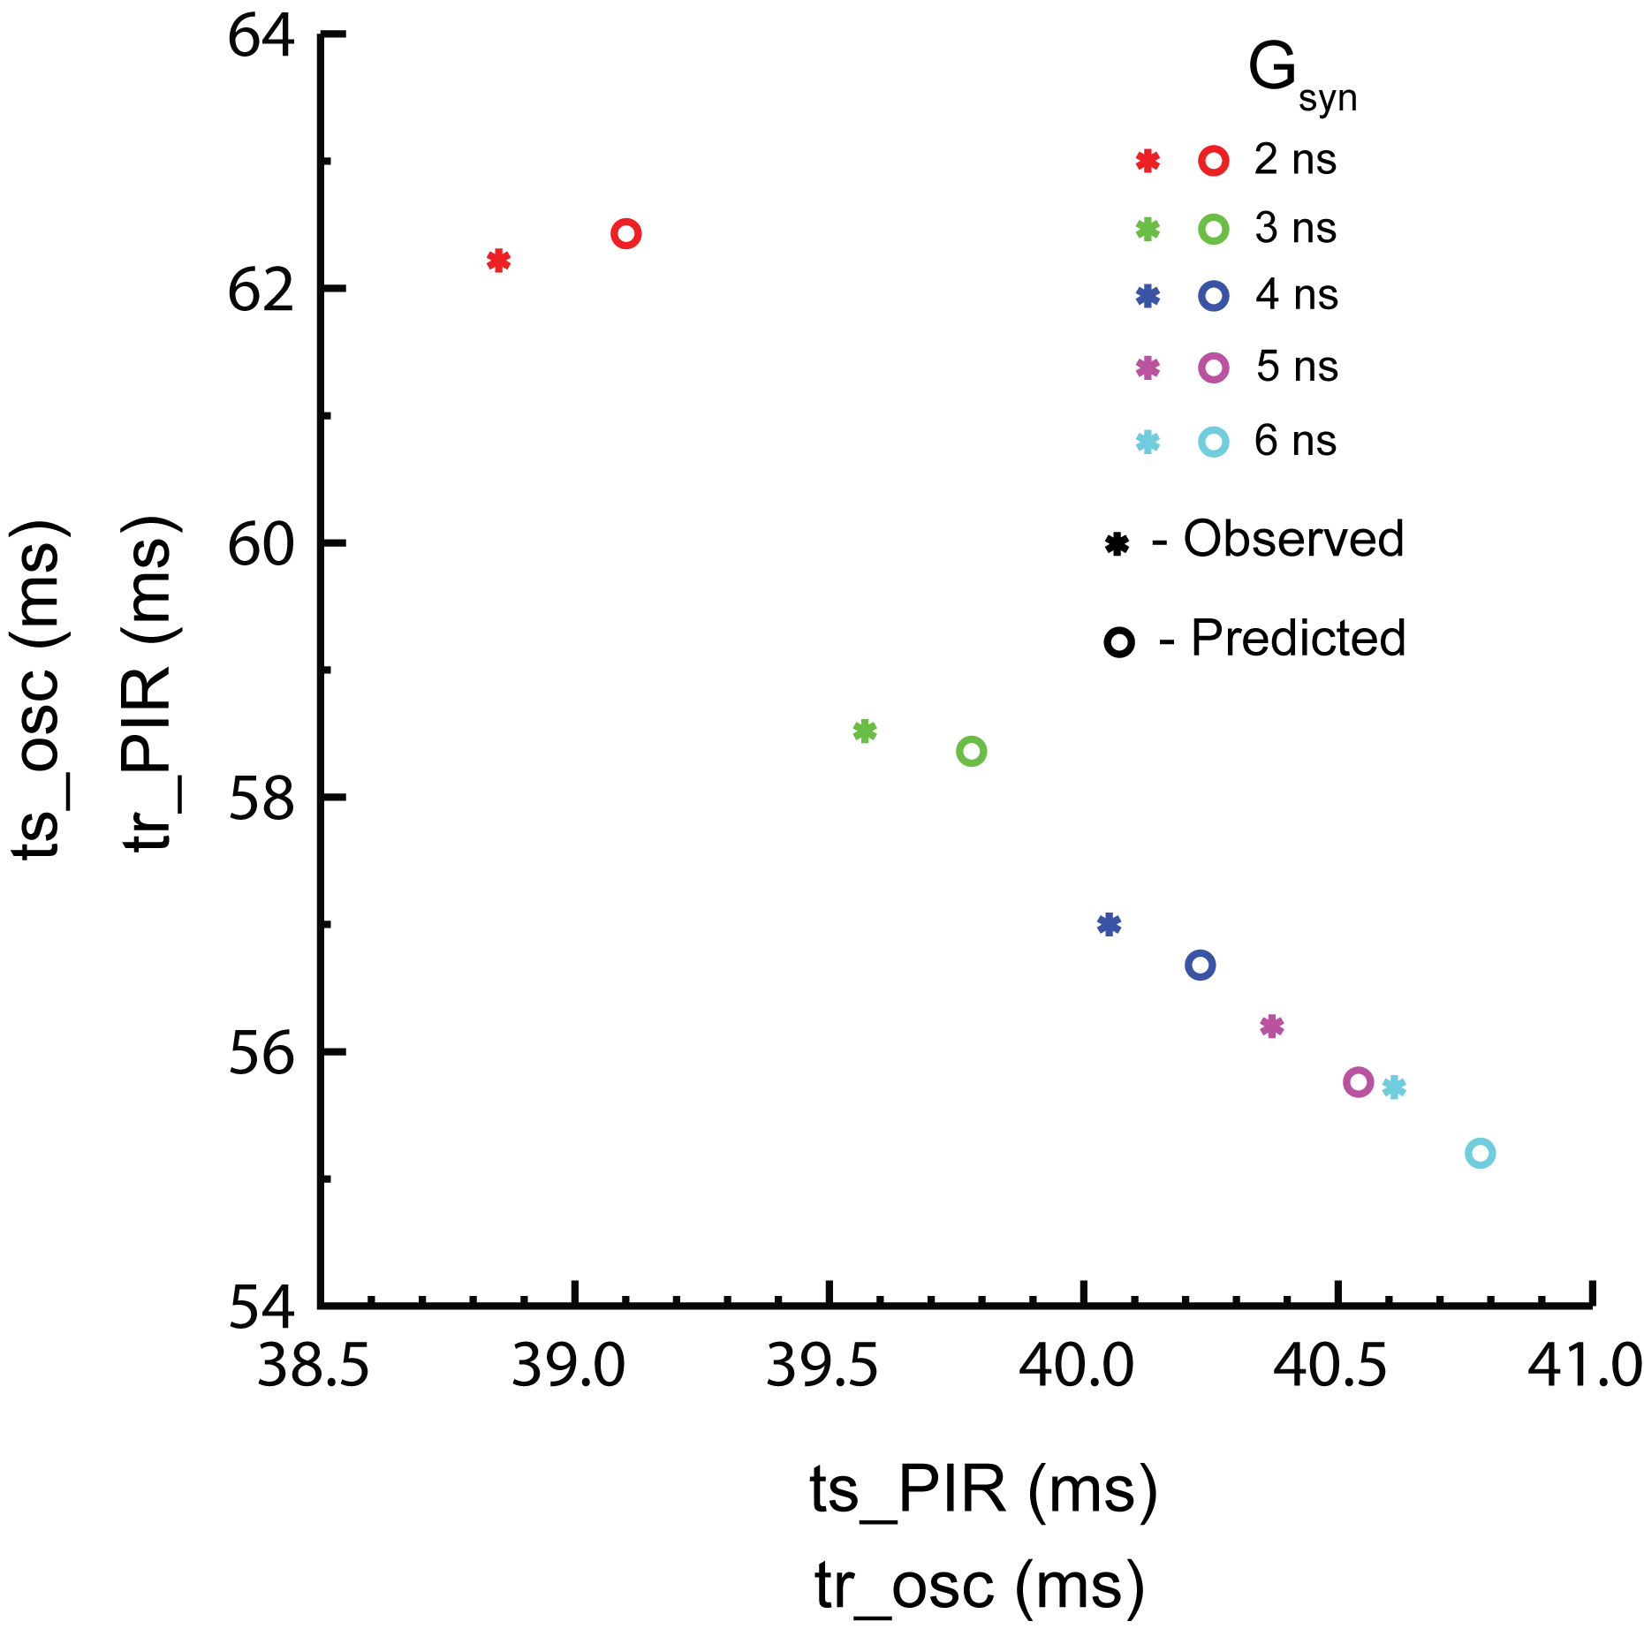
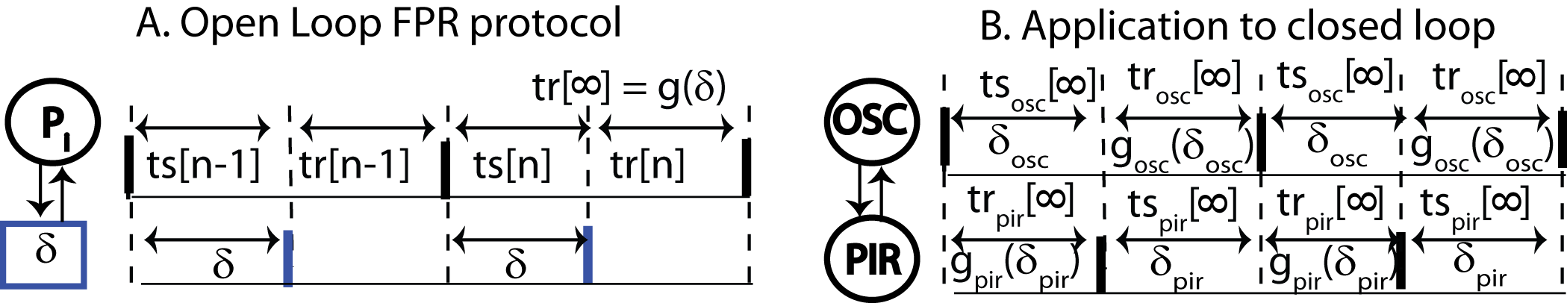
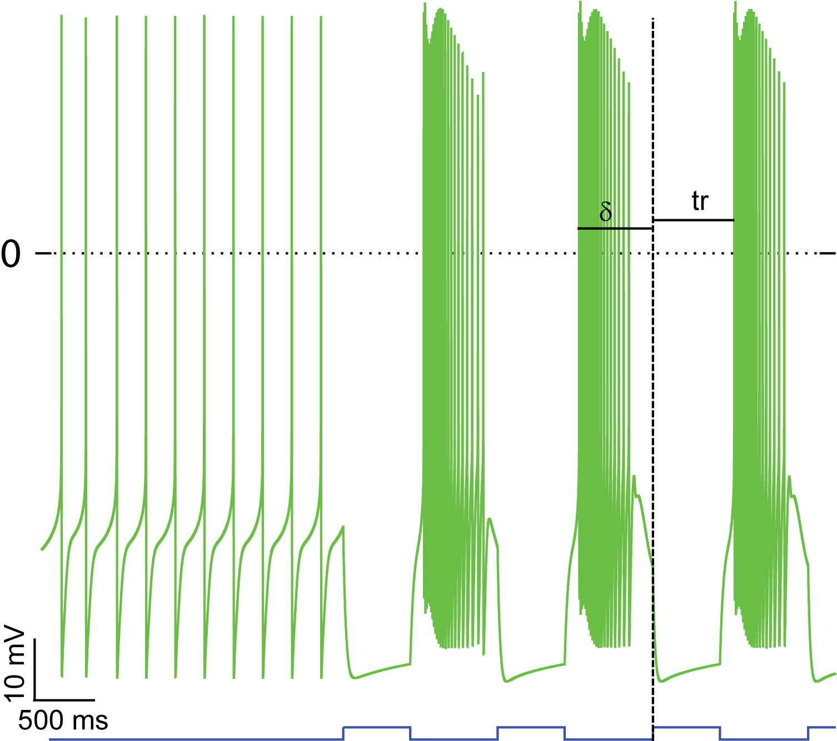
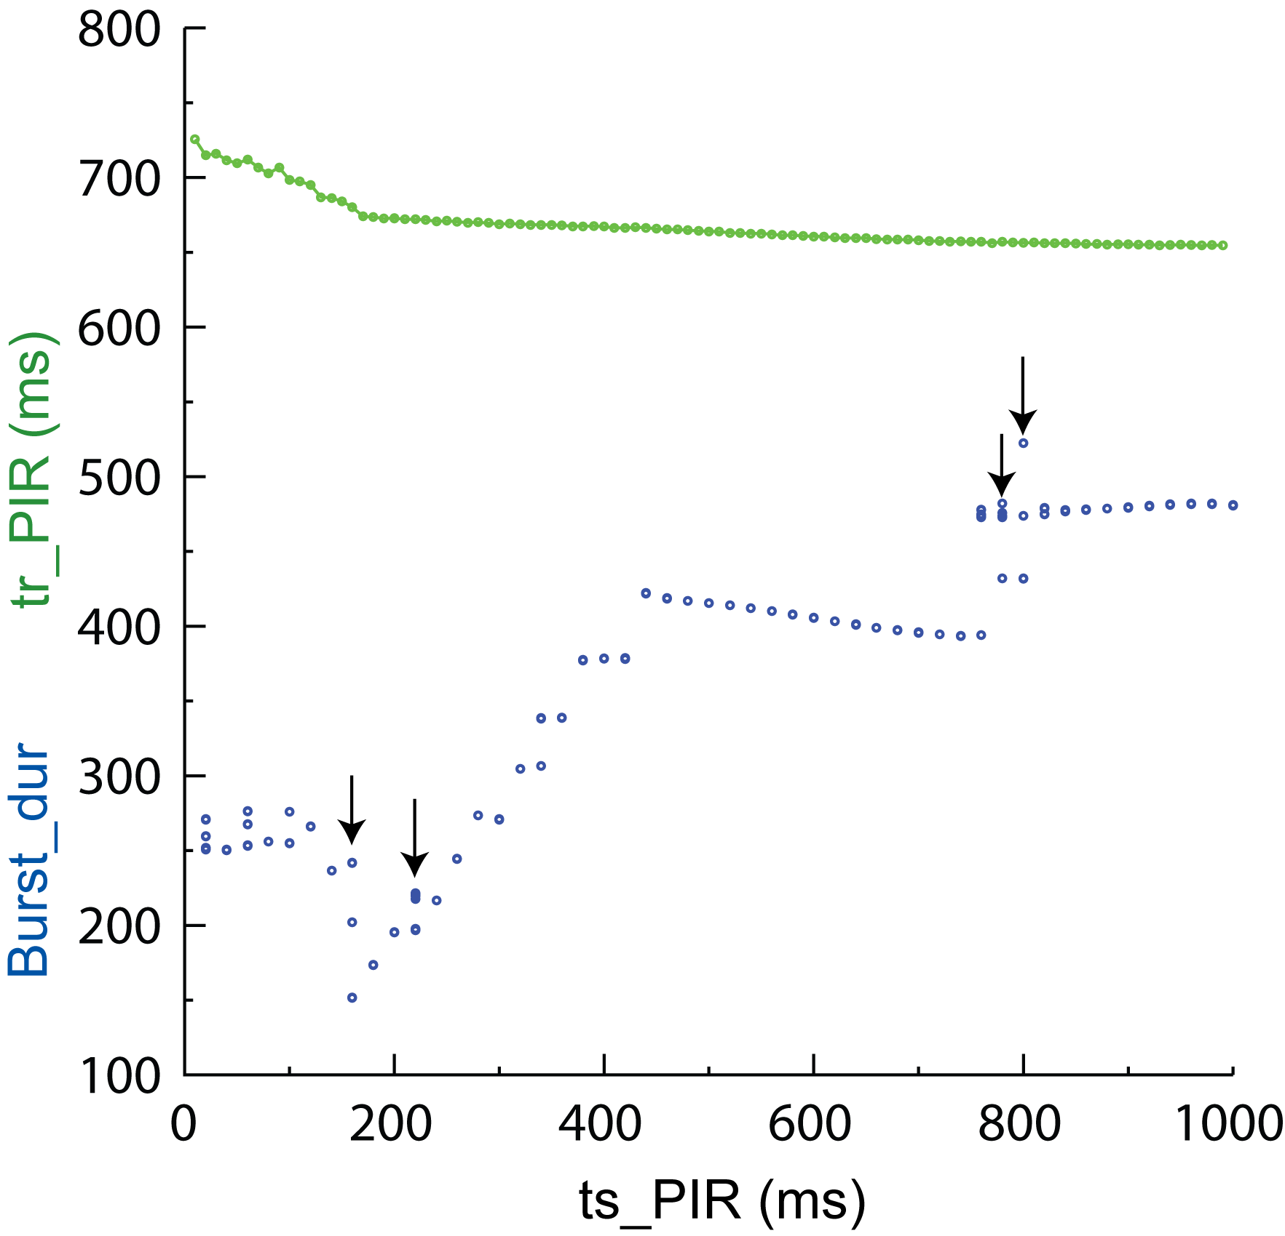
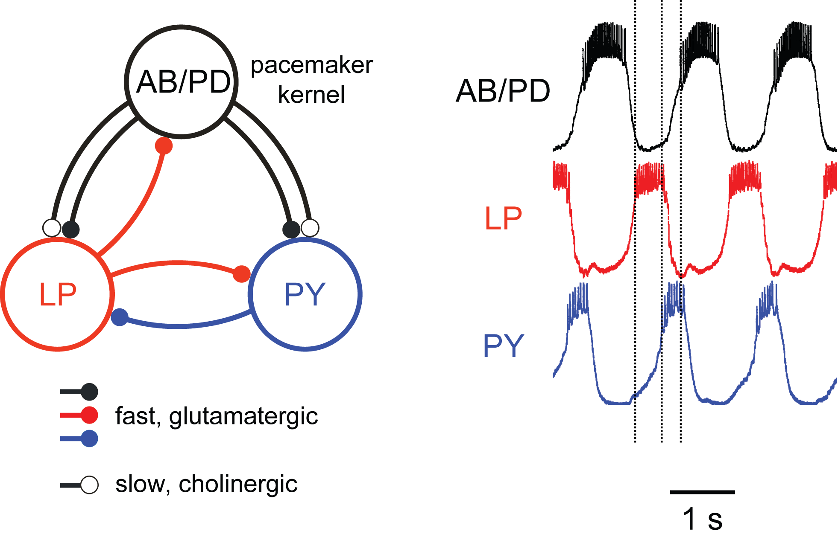
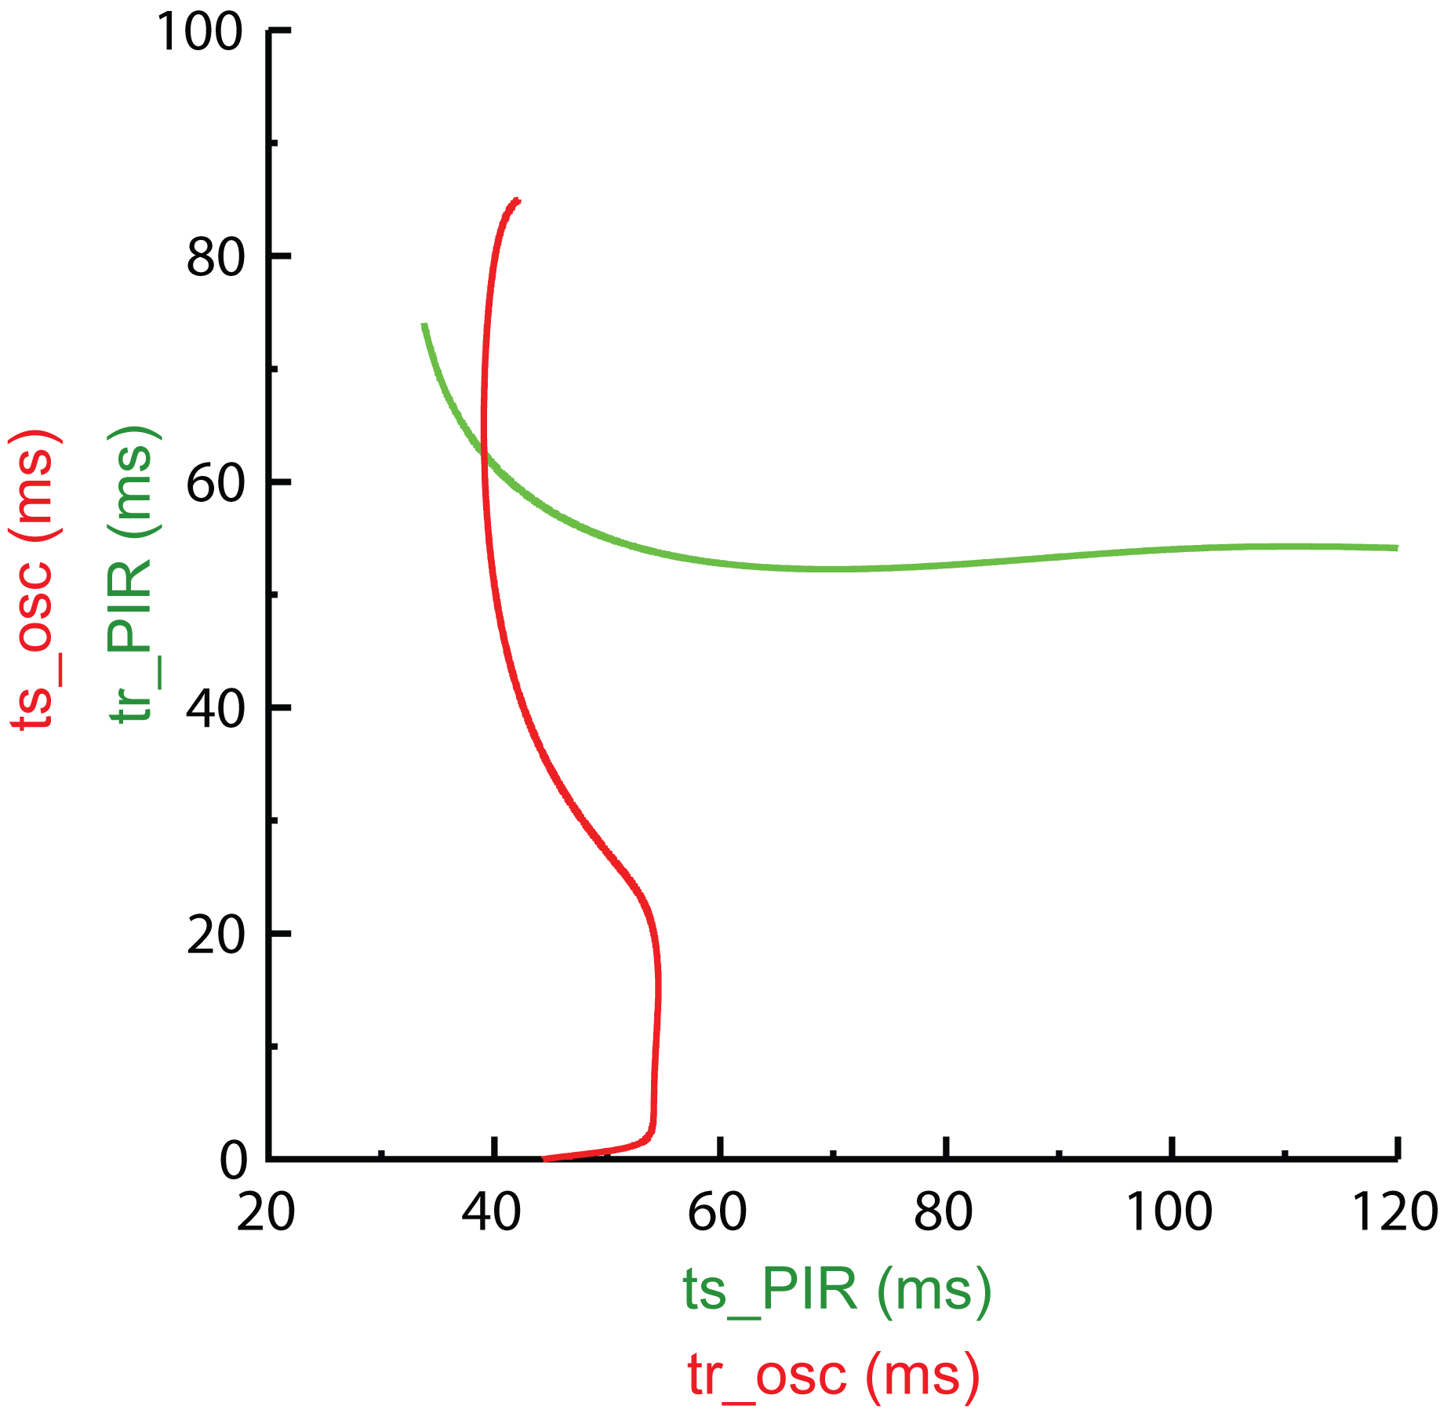
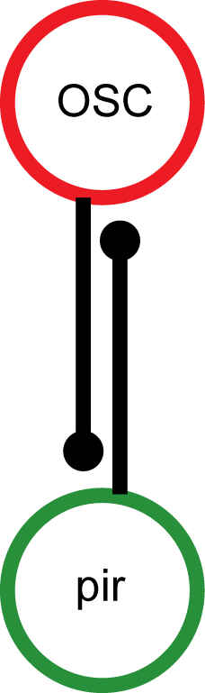
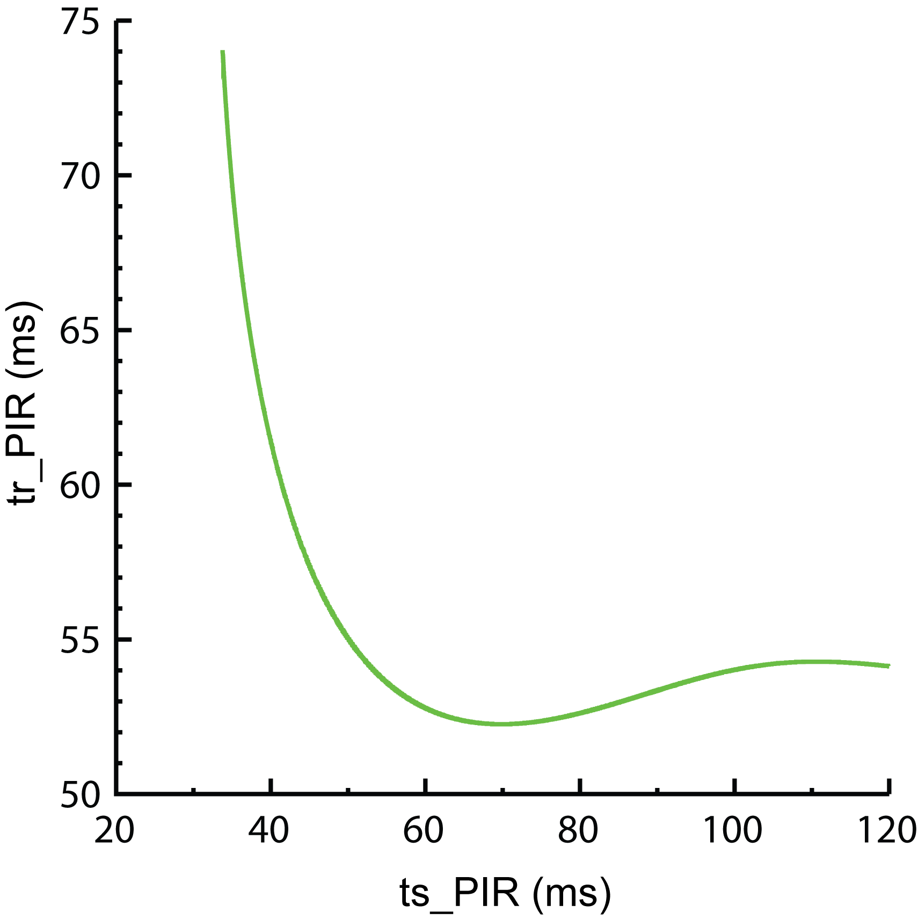
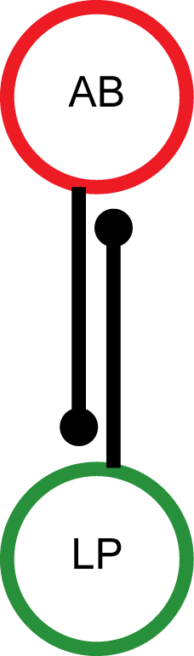
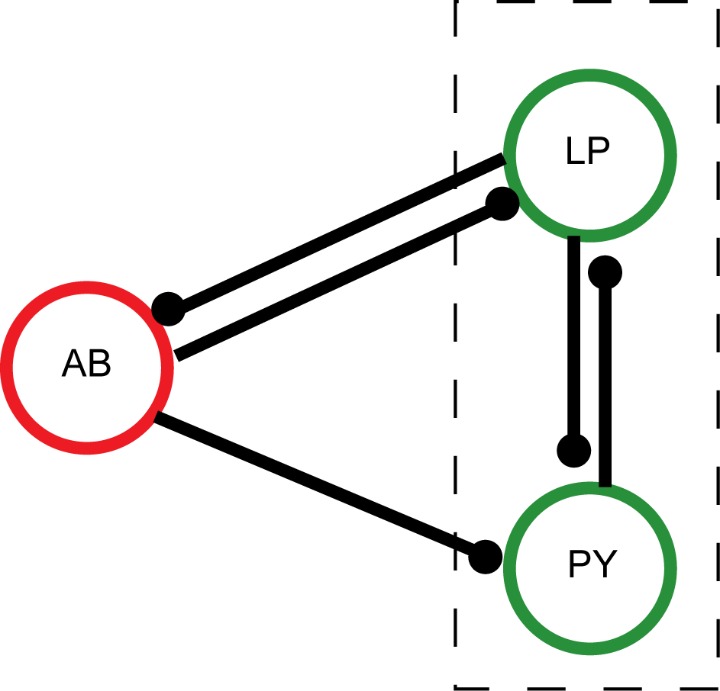
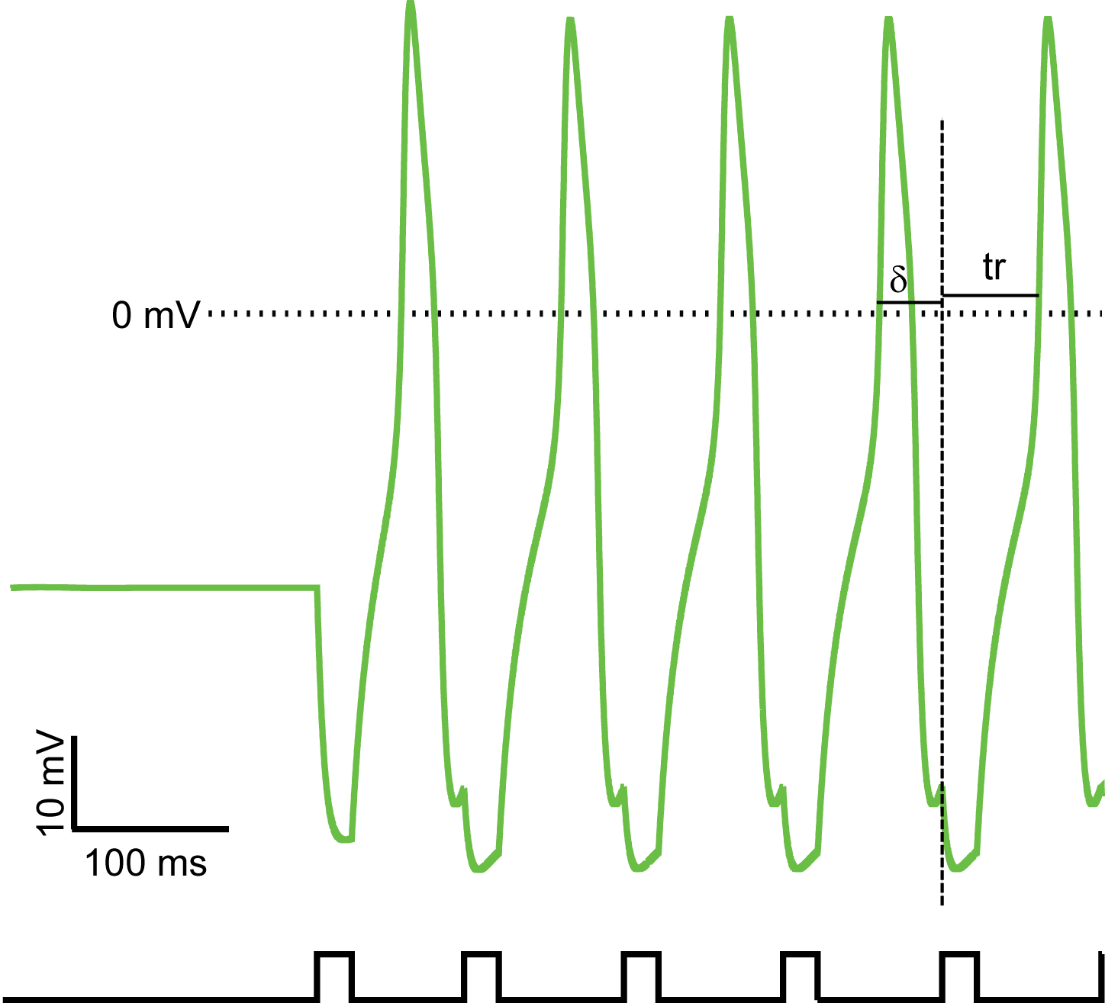
Analyzing circuits comprised of pacemakers and post-inhibitory
rebound neurons using functional phase resetting curves
# 321.8/C72
Selva K. Maran¹, F.H. Sieling³, A.A.Prinz^{2,3} and C.C. Canavier¹
¹Neuroscience Center of Excellence, LSUHSC, New Orleans, ²Biology Dept, Emory University, Atlanta, ³Wallace H. Coulter Department of Biomedical Engineering, Georgia Tech and Emory University.
Introduction
Phase locking between oscillatory AB model neuron and postinhibitory rebound LP model neuron.
Central pattern generators (CPGs) are responsible for many rhythmic behaviors such as locomotion and respiration. Many CPGs contain intrinsic bursting neurons as pacemakers, and also include other types of neuron. Neurons that exhibit postinihibitory rebound (PIR) are a common circuit element. Standard PRC theory can only be applied to pacemakers. Our hypothesis is that functional phase resetting curve (fPRC) could be used to predict phase locking in networks containing both pacemakers and PIR neurons. The fPRCs is measured by repeatedly applying a perturbation at a fixed delay after a threshold event, such as a spike or burst, until the recovery time between the perturbation and the next burst or spike stabilizes (Cui et al 2009). We examine the simplest case of one pacemaker coupled to a PIR neuron via reciprocal inhibition.
fPRC Generation for a pacemaker
Comparison of predicted stable points and observed stimulus and recovery interval in the phase locked state.
fPRC protocol
Figure 6: The models were selected from Dr Astrid Prinz Database (Prinz et al., 2003). As is the case for real LP neurons, the model LP neuron could either spike tonically or remain silent when isolated, but was capable of exhibiting a rebound burst .
Figure 3: (Left). The voltage trace of oscillatory neuron for an input given at specific delay value (δ). The duration of input corresponds to the suprathreshold interval in the PIR neuron. (Right). fPRC for oscillatory neuron. The steady state value of the recovery interval tr_OSC[∞] is tabulated as a function g_{osc}(δ_{osc}) of the fixed delay δ_{osc} (or ts_OSC[∞])
Figure 5: (Left) Observed phase locking for (G_{syn} = 2 ns) (Right ) The prediction based on fPRC is compared with the simulation results. The main reason for the small difference between observed and predicted values is due to change in the width of the action potential during network interactions.
fPRC for Model LP neuron
Figure 1. (A) For the functional PRC, an input perturbation is applied with a fixed delay δ after the onset of each threshold event (spike or burst). Contrary to intuition, the fixed delay protocol does not always produce a stable response time in a pacemaker at phase with significant second order resetting (see proof below). (B). In the closed loop two neuron network, we assume that in a phase-locked mode, the recovery time for each neuron can be calculated as a function of δ from A, where δ is equated with the stimulus time.
Prediction of Phase locked intervals
Preliminary Application of fPRC to Pyloric circuit
Stability proof for Fixed Delay for Pacemaker
δ = P_{i}{φ[n] + f₂(φ[n-1]) - 1
δ / P_{i} = φ* + Δφ[n] + f₂(φ*) + f '₂(φ*)Δφ[n-1] - 2
Figure 7: (Left) The voltage trace of a model LP neuron for an input given at specific delay value (δ). (Right). fPRC for model LP neuron using a pulse with the width of a burst in the AB model. The burst duration of the rebound bursts is highly variable, thus it is difficult to determine the appropriate perturbation with which to generate the fPRC in the AB neuron. This may be a model specific problem which will be addressed by collecting experimental fPRC data for LP.
δ / P_{i} = φ* + f₂(φ*) - 3
From 2 and 3, Δφ[n] = -f '₂(φ*)Δφ[n-1].
fPRC Generation for PIR Neuron
Conclusion
Figure 4: Since in a one to one locking tr_PIR[∞] = ts_OSC[∞] and tr_OSC[∞] = ts_PIR[∞], the possible one to one locked modes are given by the intersection of the curves obtained in Figs. 2 and 3. The order of the points plotted in Fig. 3 was reversed in order to get quantities that are supposed to be equal on the same axis.
Stability Criteria
Although the delays are not fixed in the closed loop circuit, the stability of the locking can be approximated by assuming a perturbation
of two neurons that are actually coupled by fixed delays. At steady state δ_{PIR} = g_{OSC}(δ_{OCS}) and δ_{OSC} = g_{PIR}(g _{OSC}(δ _{OSC})). Linearizing the map
δ _{OSC}[n] = g2(g _{OSC}(δ _{OSC}[n-1])) provides a stability criterion that
-1 < g _{PIR} '(ts _{PIR}[∞])g _{OSC} '(ts _{OSC} [∞]) < 1, where the prime indicates the slope at the fixed point.
Previously, both phase resetting curves and functional phase resetting curves were only used to analyze networks of oscillators. In the context of CPGs, oscillators are usually bursting neurons. We show the analysis can be extended to include either silent or tonically firing PIR neurons. Variations in burst duration may limit the analysis, but at least in the AB neuron, such variations are smaller in the real neuron than in the model we used here.
Figure 6: We plan to use the fPRC methods to analyze a specific biological central pattern generator, the pyloric circuit of the lobster and crab which includes both pacemaker and PIR neurons. First, we will apply fPRC methods to a reduced system comprised only of a single model bursting neuron representing the anterior burster/pyloric dilator (AB/PD) complex reciprocally coupled to a lateral posterior (LP) postinhibitory rebound (PIR) neuron, then extended to the triphasic rhythm generator by adding a PIR single neuron representing the pyloric constrictor (PY) population.
Figure 2: For proof of principle, we used Type II Morris Lecar model neurons. The coupling conductance was only active when the presynaptic membrane potential was above zero to approximate the envelope of a bursting neuron, and the synaptic reversal potential was -75 mV. For the PIR neuron, a constant hyperpolarizing current is applied to make the neuron silent at rest. The key idea is that although a PIR neuron does not oscillate spontaneously, the first pulse “kick starts” an oscillation, and input trains at different fixed delays from spike onset can be applied. (Left). The voltage trace of PIR neuron for an input given at specific delay value (δ). The synaptic conductance was on during the pulses shown at the bottom. (Right). fPRC for PIR neuron. The steady state value of the recovery interval tr_PIR[∞] is tabulated as a function g_{pir}(δ_{pir}) of the fixed delay δ_{pir} , which in the circuit is equated to ts_PIR[∞] (see Fig. 1).
References:
Cui J, Canavier CC, Butera RJ. Functional phase response curves: a method for understanding synchronization of adapting neurons. J Neurophysiol. 2009 Jul;102(1):387-98. Epub 2009 May 6
Prinz AA, Billimoria CP, Marder E. Alternative to hand-tuning conductance-based models: construction and analysis of databases of model neurons. J Neurophysiol 90: 3998-4015 (2003)
Supported by CRCNS grant NIH NS54281

